Slide 1

DevOps Fundamentals
.NET

Slide 2
DevOps is the union of people, process, and products to enable continuous delivery of value to end users.
https://docs.microsoft.com/en-us/azure/devops/learn/what-is-devops

Slide 3
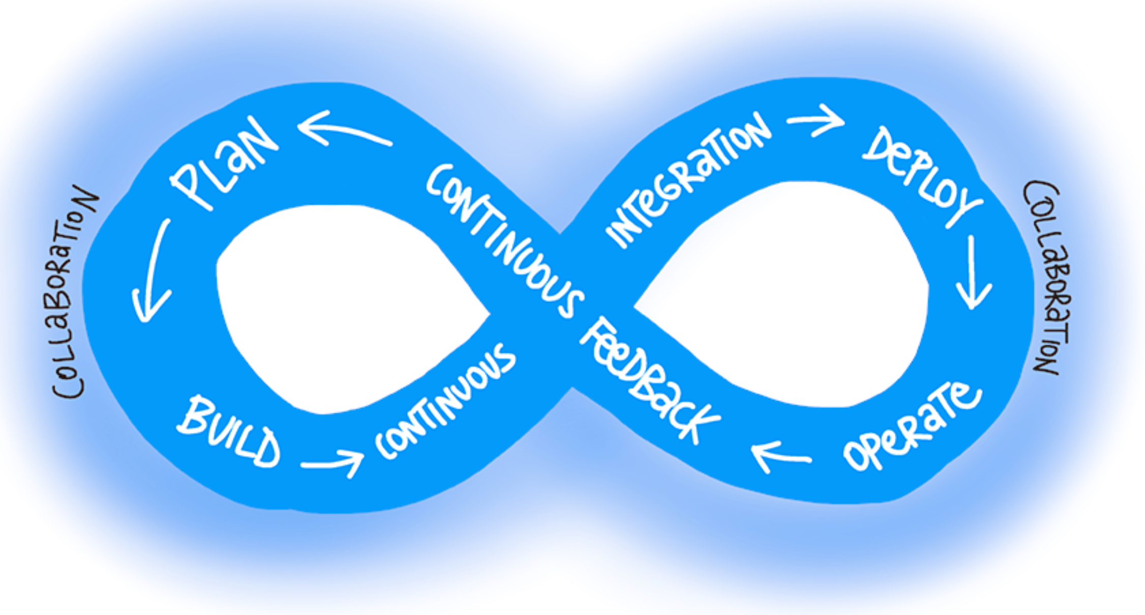
What is DevOps? https://docs.microsoft.com/en-us/azure/devops/learn/what-is-devops
The contraction of “Dev” and “Ops” refers to replacing “Siloed” DEVelopment and OPerations Teams.
With DevOps, multidisciplinary teams work together with shared, more efficient practices and tools.
Essential DevOps practices include:
Agile planning,
Continuous Integration,
Continuous Delivery, and
monitoring of applications.

Slide 4
Who is DevOps? https://docs.microsoft.com/en-us/azure/devops/learn/what-is-devops
DevOps is the combination of the processes of the:
Business team,
IT team,
Development team
In DevOps, these teams form a feedback loop that has a shared goal.
The Dev team plans and builds the app.
The IT team deploys and maintains the app.
The Business Team verifies that the correct product is created and delivered.
DEV
I.T.
Business

Slide 5
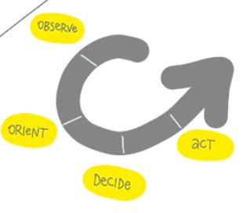
DevOps and The O.O.D.A. Loop https://docs.microsoft.com/en-us/azure/devops/learn/what-is-devops#understand-your-cycle-time http://www.slideshare.net/adriancockcroft/speeding-up-31799721
The OODA loop:
O - Observe business and market needs and current user behavior.
O - Orient with the options for what you can deliver.
D - Decide what goals to pursue.
A - Act by delivering working software to real users.
The four OODA Loop steps occur in a Cycle Time. The Cycle repeats until a project is complete.

Slide 6
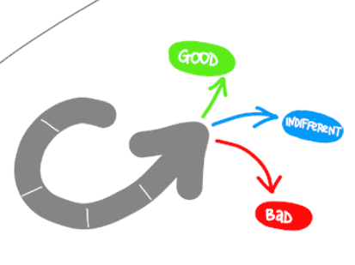
The OODA Loop - Cycle Time https://docs.microsoft.com/en-us/azure/devops/learn/what-is-devops#understand-your-cycle-time http://www.slideshare.net/adriancockcroft/speeding-up-31799721
Your Cycle Time is determined by how quickly you can complete the four steps.
The feedback that you gather with each cycle should be real, actionable data. Something should be learned from each cycle. This is called Validated Learning.

Slide 7
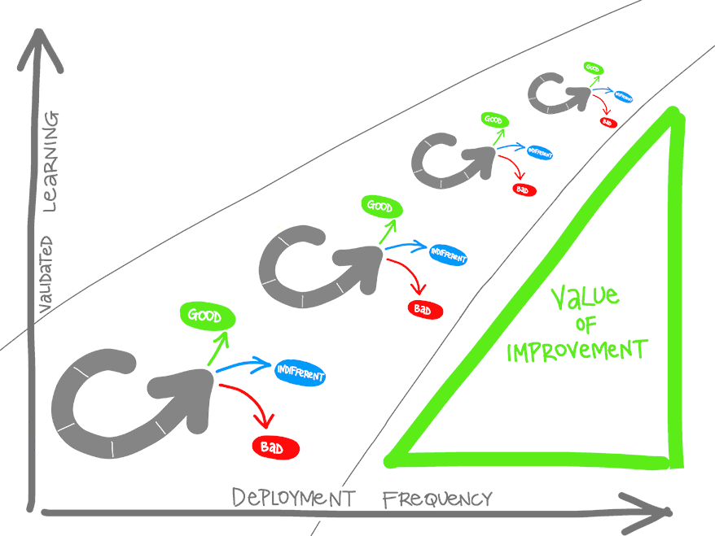
DevOps shortens Cycle Time https://docs.microsoft.com/en-us/azure/devops/learn/what-is-devops#shorten-your-cycle-time
When DevOps practices are adopted, smaller, more focused teams will:
use more automation,
improve the release pipeline, and
deploy more frequently.
The more frequent the deployment, the more experimentation can be done, and the more opportunity there is to gain Validated Learning after each cycle.

Slide 8
Achieving Devops https://docs.microsoft.com/en-us/azure/devops/learn/what-is-devops#how-to-achieve-devops
The overall goal is to shorten the project Cycle Time to zero.
This is achieved through Continuous Integration and Continuous Delivery (CI/CD).

Slide 9
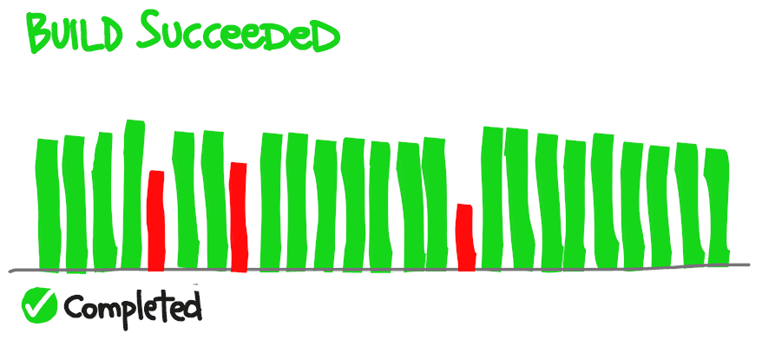
CI- Continuous Integration https://docs.microsoft.com/en-us/azure/devops/learn/what-is-devops#how-to-achieve-devops
Continuous Integration (CI) is the process of automating the build and testing of code every time a team member commits changes to version control (GitHub). Ideally, changes are committed multiple times per day. Developers merge even small changes to version control.
To achieve Continuous Integration, the commit of new code triggers an automated build system to grab the new code from the shared repository and build, test, and validate the full master branch.
Constantly merging code avoids
merge conflicts,
duplicated efforts, and
divergent strategies.
A developer submits a “pull request” when a feature or change is complete. The changes are accepted and merged into the master branch. Then the feature branch is deleted.

Slide 10
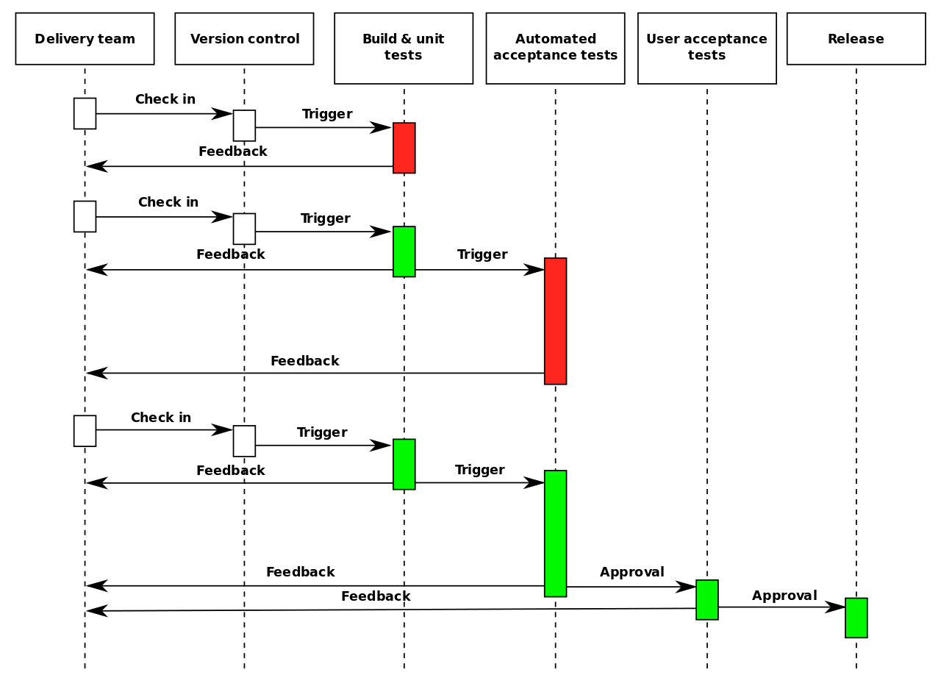
CD – Continuous Delivery https://docs.microsoft.com/en-us/azure/devops/learn/what-is-continuous-delivery
Continuous Delivery/Deployment (CD) has been shown to achieve the shortest path from new code to final deployment.
CD is the process of building, testing, configuring, and deploying code to a production environment.
A Release Pipeline is made up of multiple build, test, or staging environments which are used to automate the deployment. Automation is preferred because manual processes are unreliable and produce delays and errors.
Without Continuous Delivery, software release cycles become a bottleneck for dev teams.
An automated Release Pipeline allows a “fail fast” approach to validation, where tests fail quickly so code can be immediately refactored.
Continuous Delivery
Continuous Deployment

Slide 11
Continuous Delivery vs Continuous Deployment https://aws.amazon.com/devops/continuous-delivery/
Continuous Delivery is when code changes are automatically prepared for a release to production. Continuous Delivery expands upon Continuous Integration by deploying all code changes to a testing environment and/or a production environment after the build stage.
When properly implemented, developers will always have a deployment-ready build artifact that has passed through a standardized test process and is ready for manual testing.

Slide 12
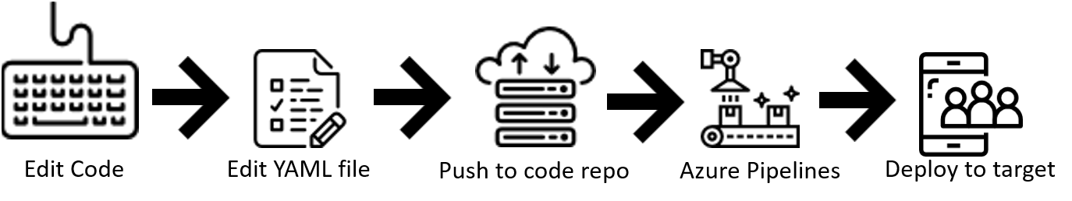
Azure DevOps - Introduction https://docs.microsoft.com/en-us/azure/devops/pipelines/ecosystems/dotnet-core?view=azure-devops https://docs.microsoft.com/en-us/azure/devops/pipelines/get-started/pipelines-get-started?view=azure-devops https://docs.microsoft.com/en-us/azure/devops/pipelines/?view=azure-devops
Azure Pipelines is a cloud service that you can use to automatically build and test your code and make it available to other users. Azure Pipelines works with many language or project types.
Azure Pipelines combines Continuous Integration (CI) and Continuous Delivery (CD) to constantly test and build your code to be shipped to any target.

Slide 13
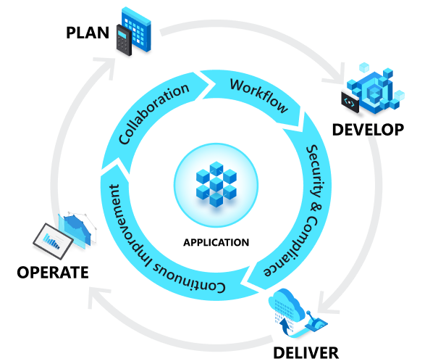
Build Definition https://docs.microsoft.com/en-us/aspnet/web-forms/overview/deployment/configuring-team-foundation-server-for-web-deployment/creating-a-build-definition-that-supports-deployment#task-overview
A build definition is the mechanism that controls how and when builds occur. Azure DevOps uses a .yml file to define a build. Each build definition specifies:
The things you want to build.
The criteria that determine when a build should take place
The location to which the Build should send build outputs.
The amount of time that each build should be retained.
Various other parameters of the build process.

Slide 14
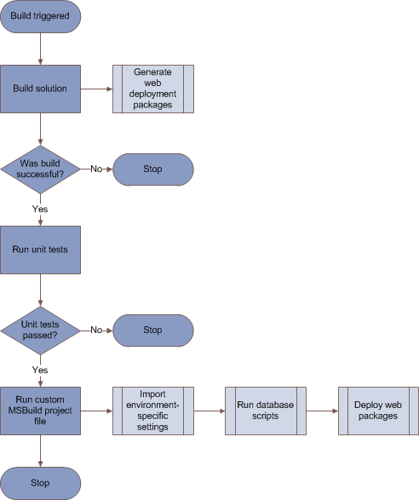
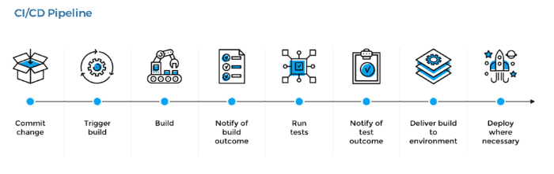
Release Pipeline https://docs.microsoft.com/en-us/azure/devops/pipelines/release/?view=azure-devops
Release pipelines in Azure Pipelines help your team implement CI/CD and deliver software to your clients faster and with lower risk.
You can fully automate the testing, delivery, and analysis of your software all the way to production or set up semi-automated processes with required approvals and on-demand deployments.
This flow chart illustrates a typical build/test/deploy workflow.

Slide 15
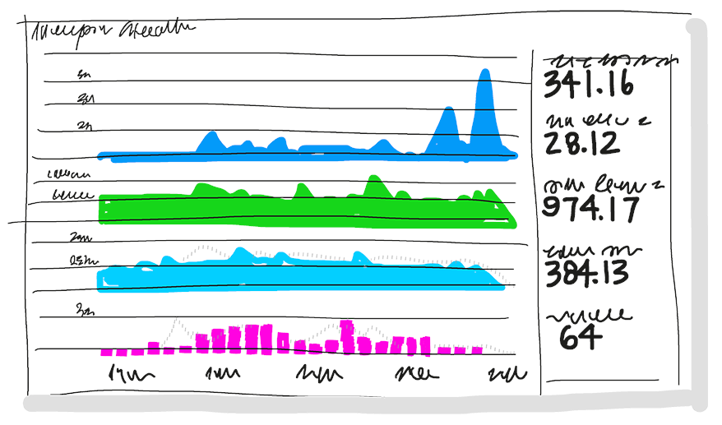
Pipeline Monitoring and Logging https://docs.microsoft.com/en-us/azure/devops/learn/what-is-monitoring
Monitoring should be built into the Pipeline to allow “test in production”.
Monitoring enables Validated Learning by immediately delivering details about an application’s performance and usage patterns.
Issues are immediately fed back to development teams via the automated build, test, and report phases in the process. The team can quickly pivot their strategy if needed.
There are various third-party sites to which the pipeline can report testing code coverage and code quality analysis.

Slide 16
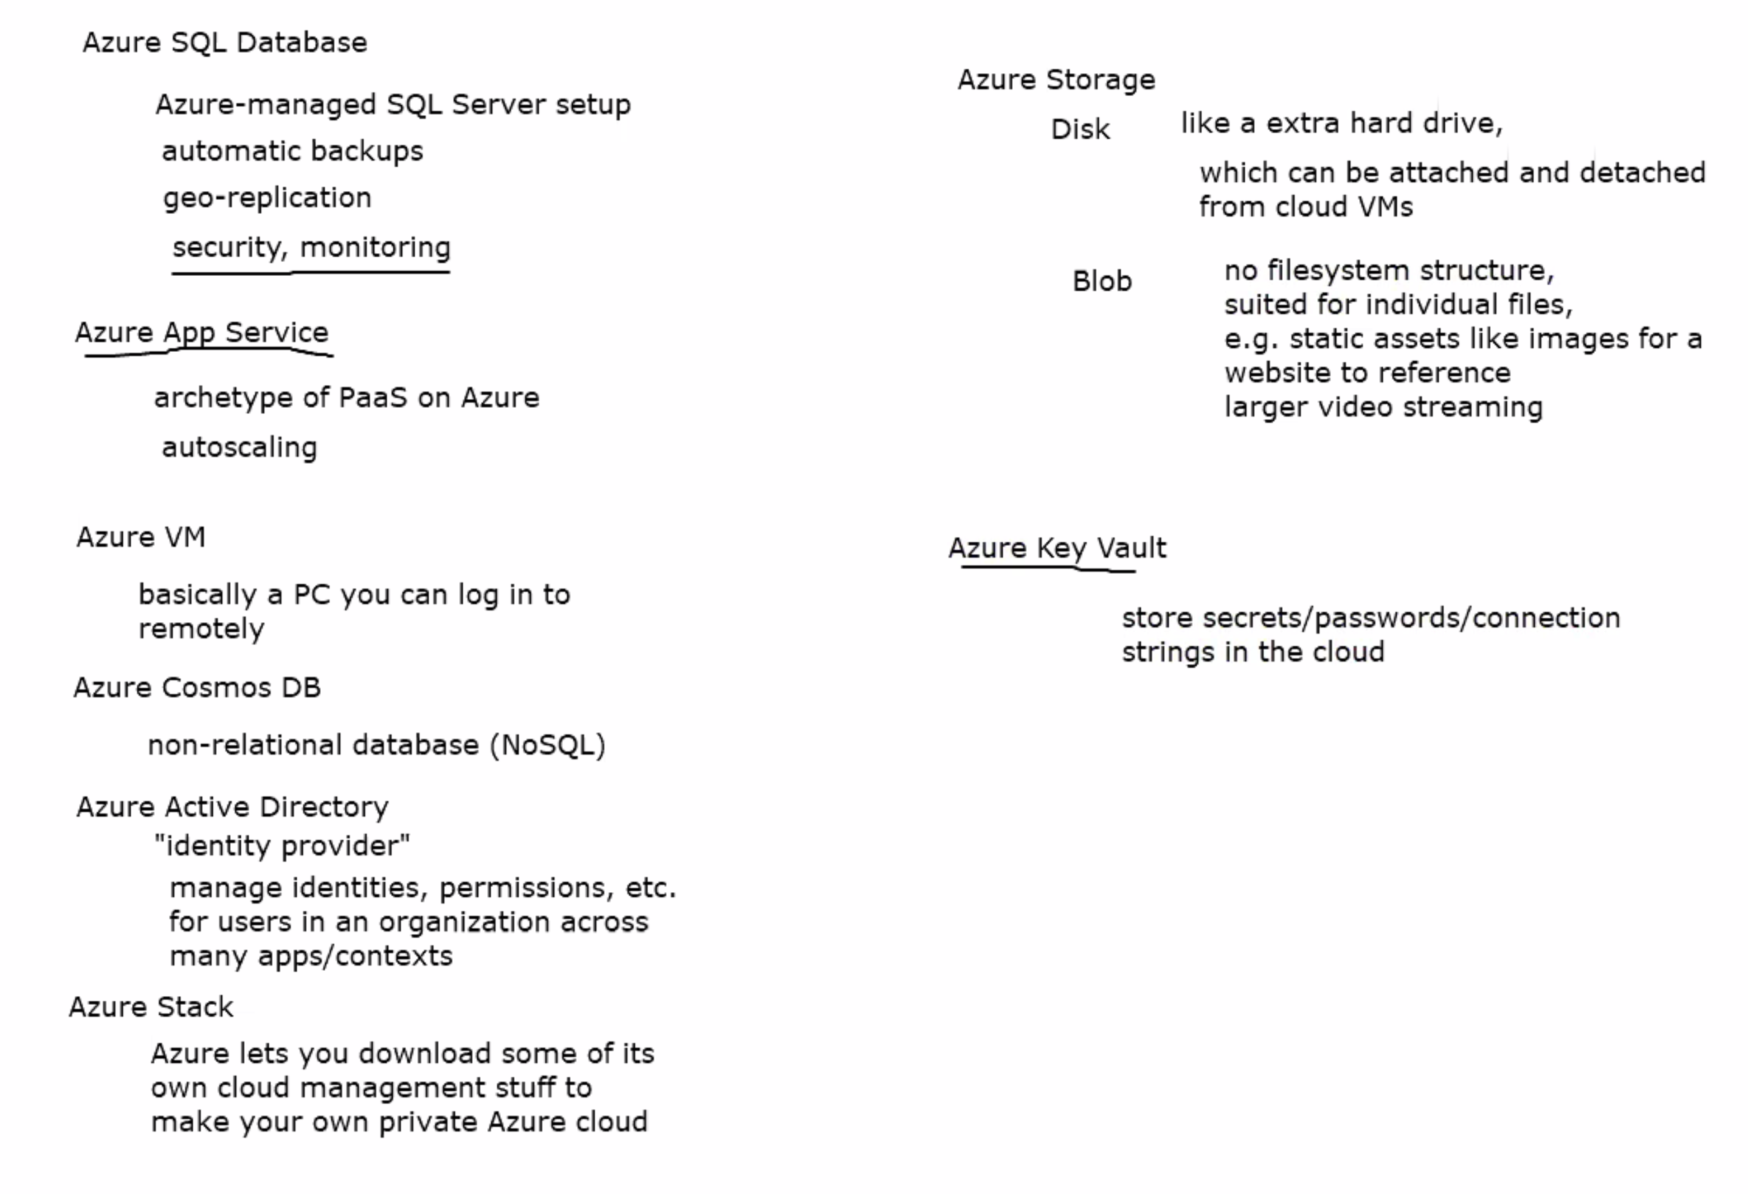
Azure SQL DB

Slide 17
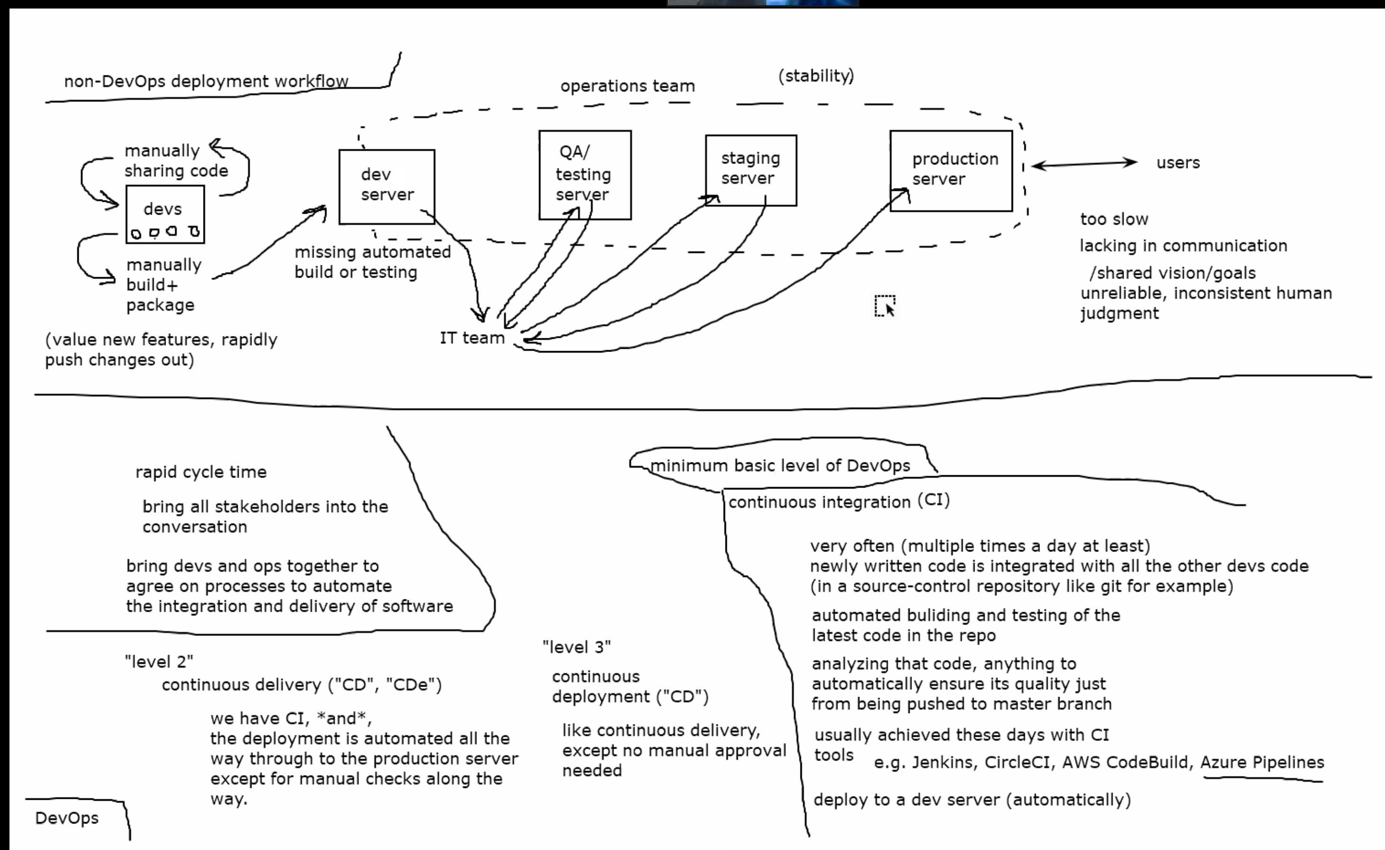

Slide 18
End of presentation

Slide 19
What is the pipeline? https://www.gocd.org/getting-started/part-1/
Show them the “This is a pipeline” image.. To break down the process of what a pipeline does. Here they are called tasks… in Azure they are called “Stages” inside the stages there are “Jobs”.
https://docs.gocd.org/current/introduction/concepts_in_go.html

Slide 20
Demo and classwork
Create a new WebAPI template and show that it works.
In the YAML, anything NOT in a list (denoted by ‘-’) runs in parallel.
https://docs.microsoft.com/en-us/azure/devops/pipelines/yaml-schema?view=azure-devops&tabs=schema%2Cparameter-schema#triggersazure pipelines

